Slide 1
Met Data Analysis
COMP 4447 – Winter 2025
Gabe Barela & Reid Holben

Slide 2

Research Question
Examine the history of the Metropolitan Museum of Art’s collection via accession date and object history dates
See if it is possible to predict which objects are classified in each department
Dataset from museum’s open access portal – last updated June 17th 2023. Minimal metadata

Slide 3
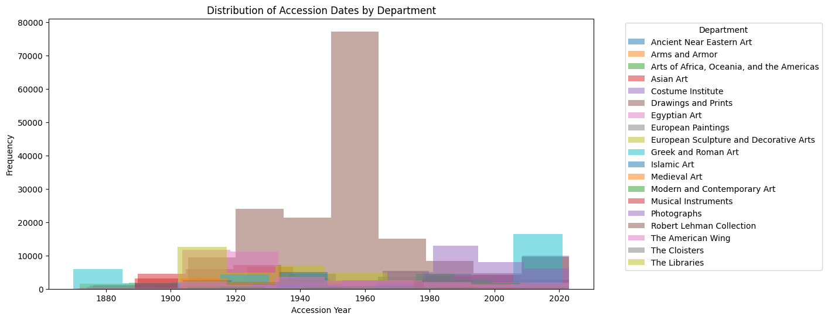
Notes:
This slide shows our initial findings without modifying the dataset. As you can see, there are some decades that are massive outliers. Can mention object start date graph looked even worse (both looked bad together on a slide). Hence why we went for outlier detection. First note of Robert Lehman Collection in brown

Slide 4
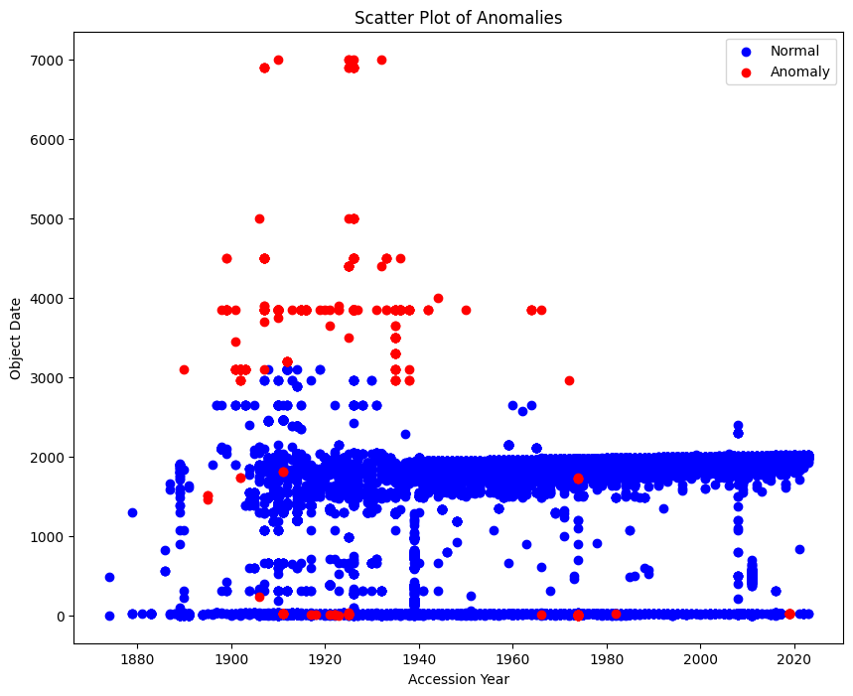
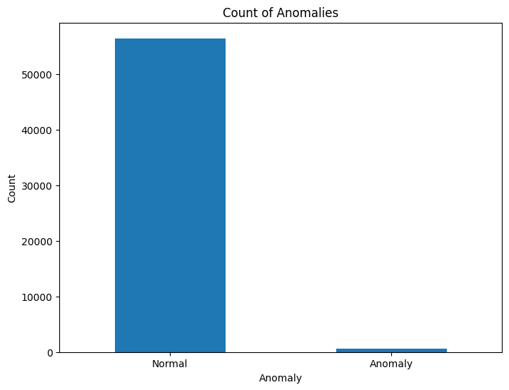
Outlier Detection
Notes:
Gabe, you can talk here about the isolation forest and how you identified the outliers – your area of expertise. Can point out object date is graphed with some breaking the scale

Slide 5
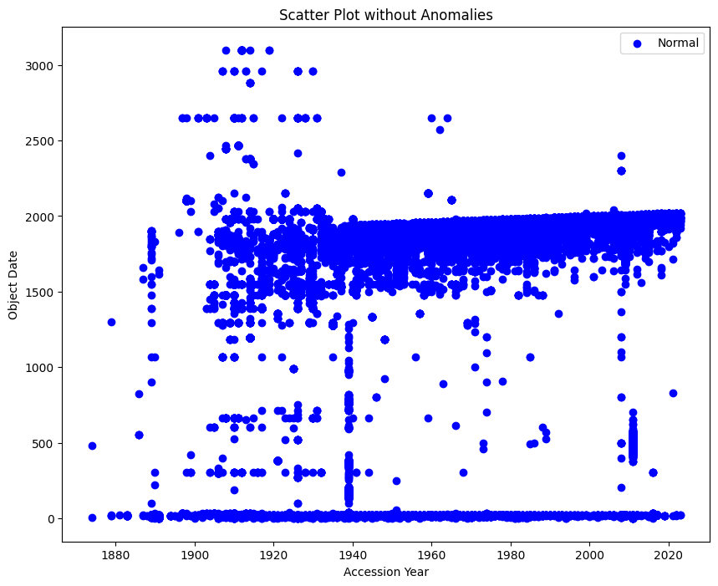
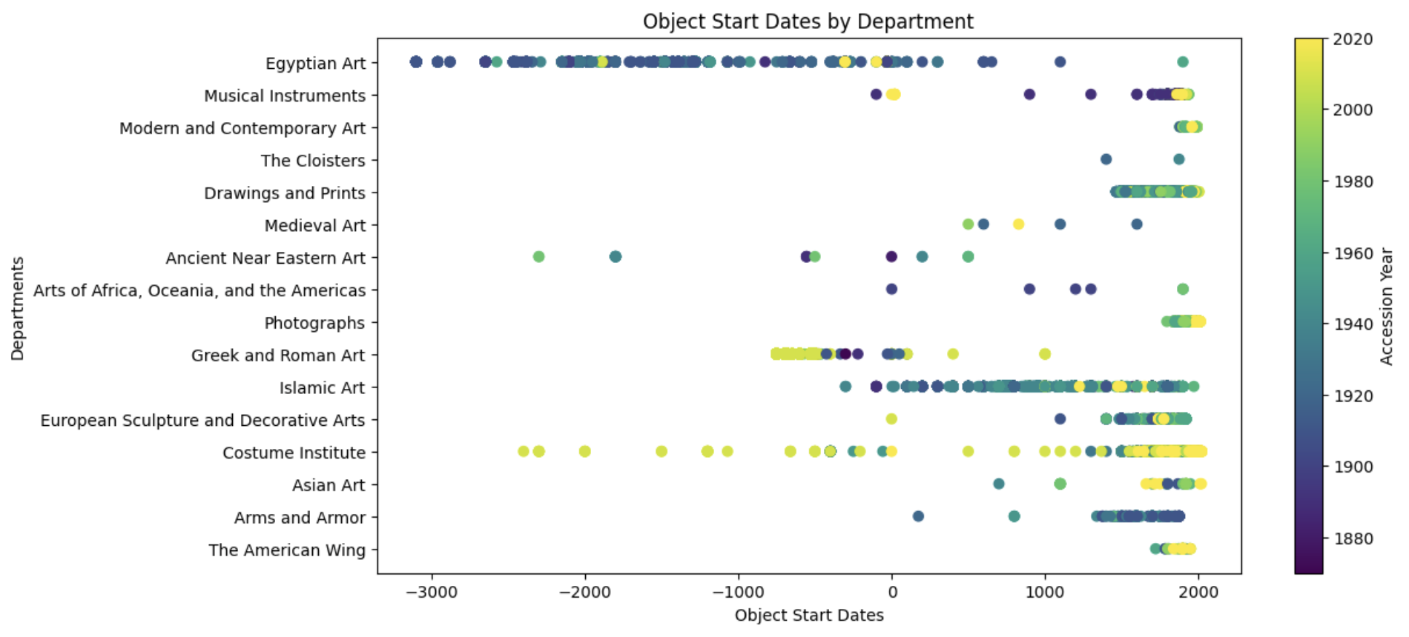
1
Notes:
Here, discuss the scatter plot’s range making much more sense. Now graphs of Object Start Date are actually readable, before there were small items well order than 3000 BC breaking the scale.

Slide 6
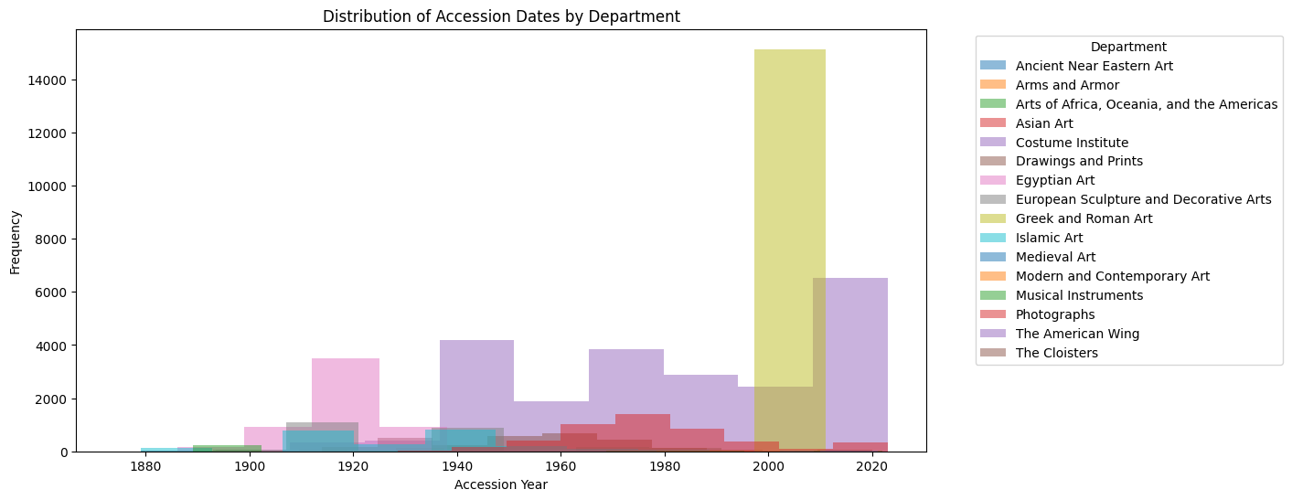
Notes:
Things look more uniform now, but we can see a massive expansion of Greek and Roman Art still not considered an outlier. Can note entire departments were removed, such as the Robert Lehman collection – all donated upon his death in 1969 and still classified together.

Slide 7
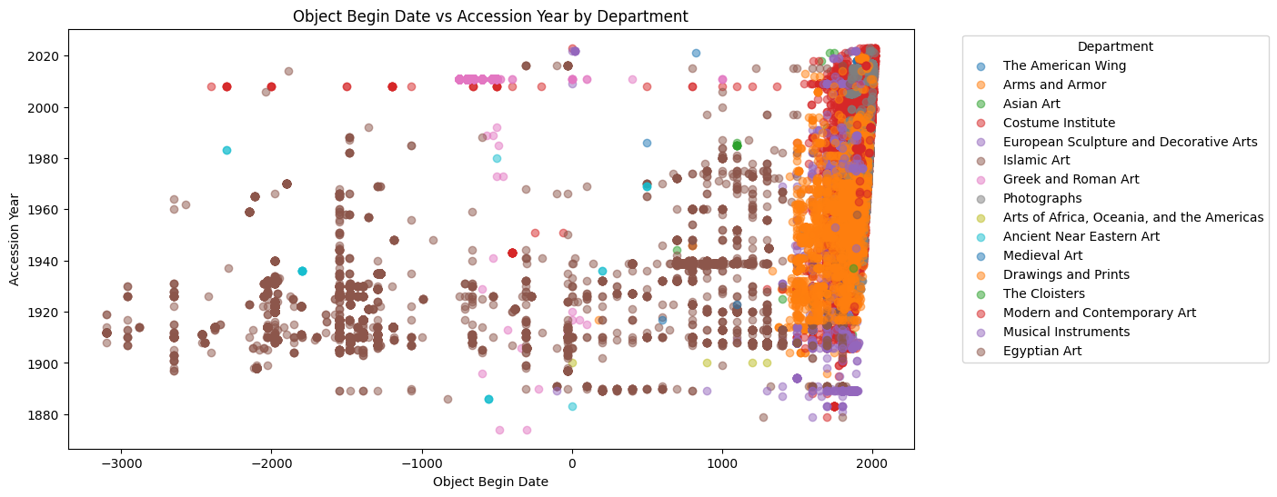
Notes:
This shows how most pieces in the collection are from last 500 years but strong presence of Egyptian Art. This will be Gabe’s last slide

Slide 8
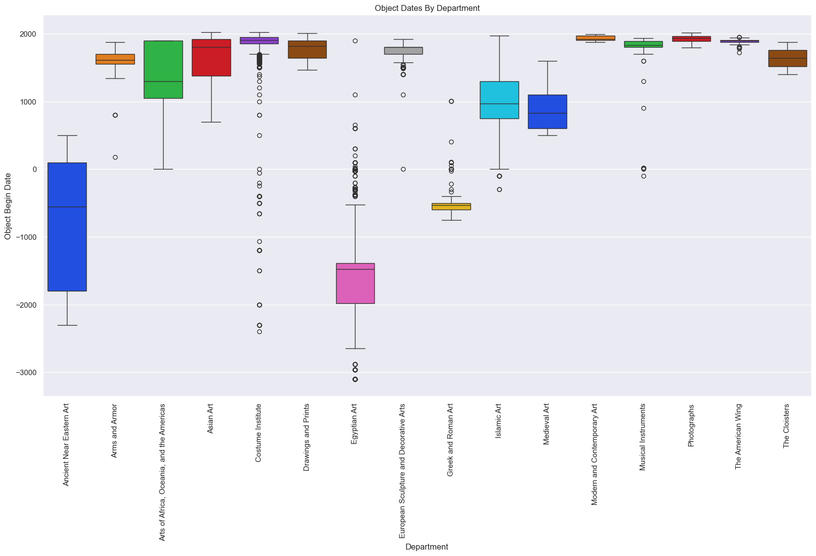
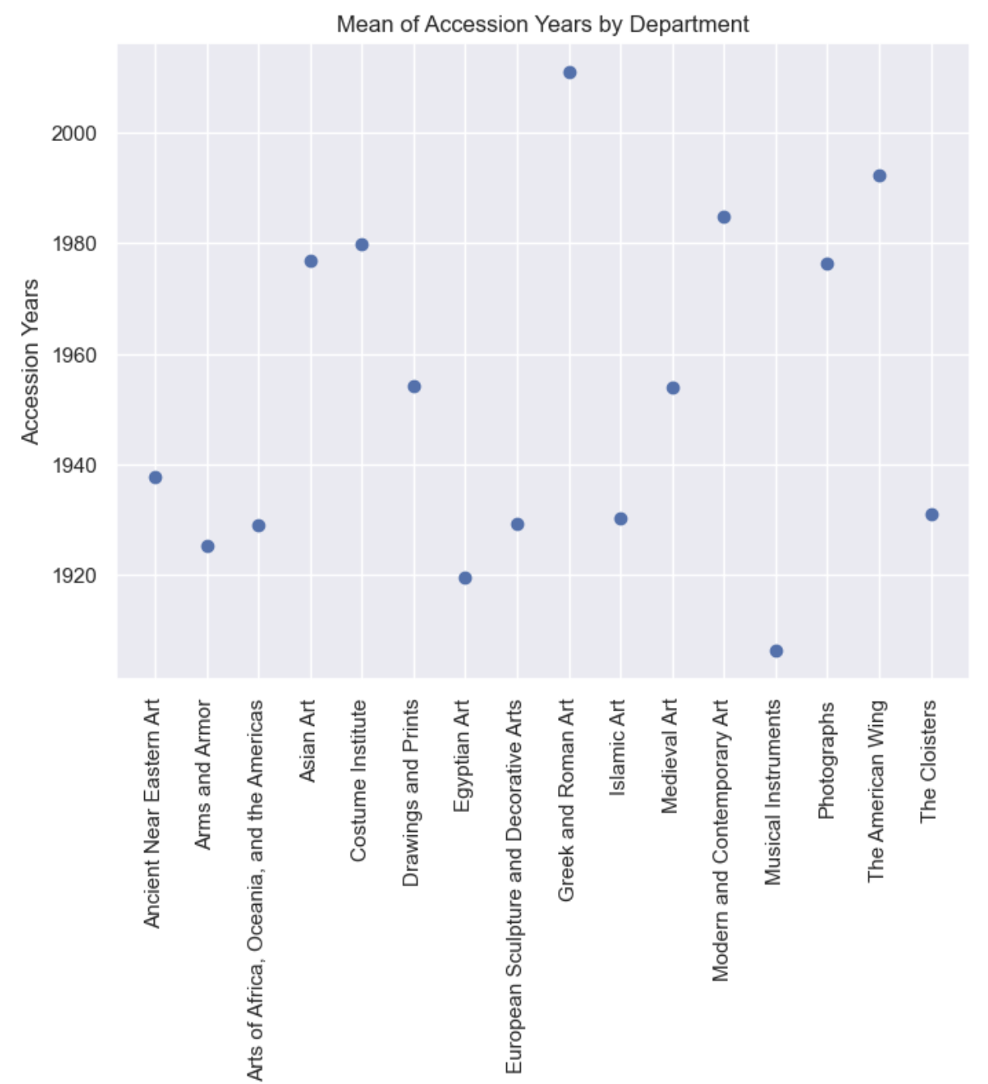
Notes:
Reid takes over presentation again. With anomalies removed, one could start to do analysis of different objects in different departments. The outliers in regards to age are clear

Slide 9
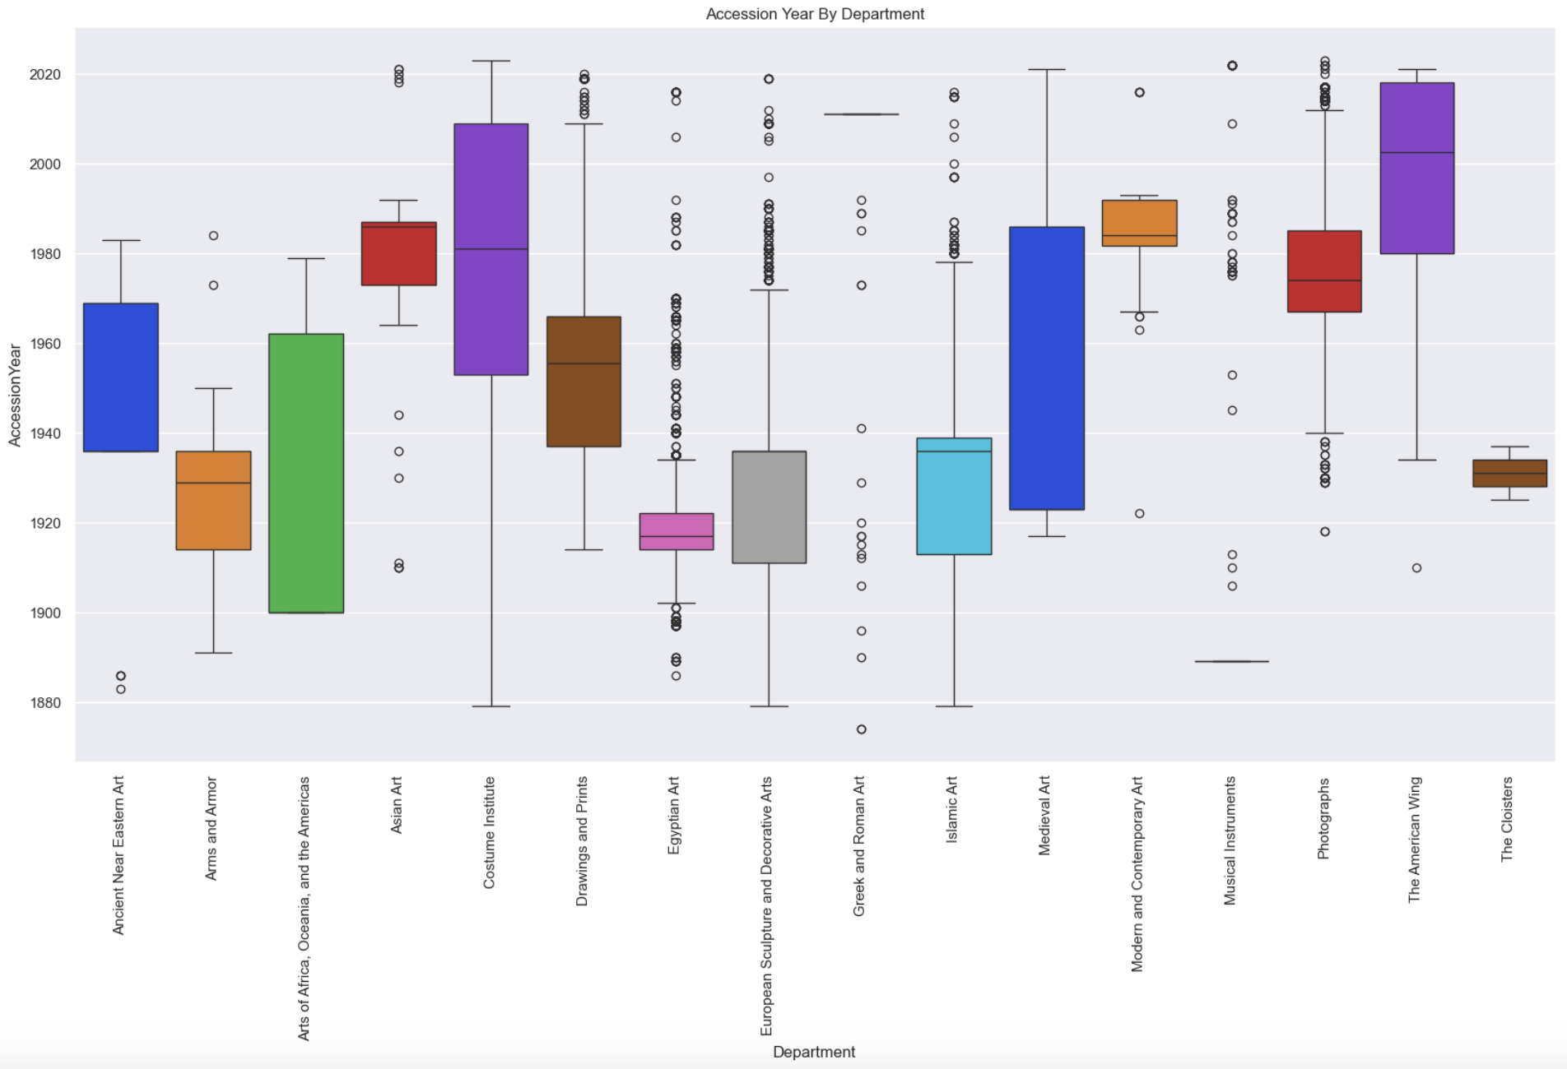
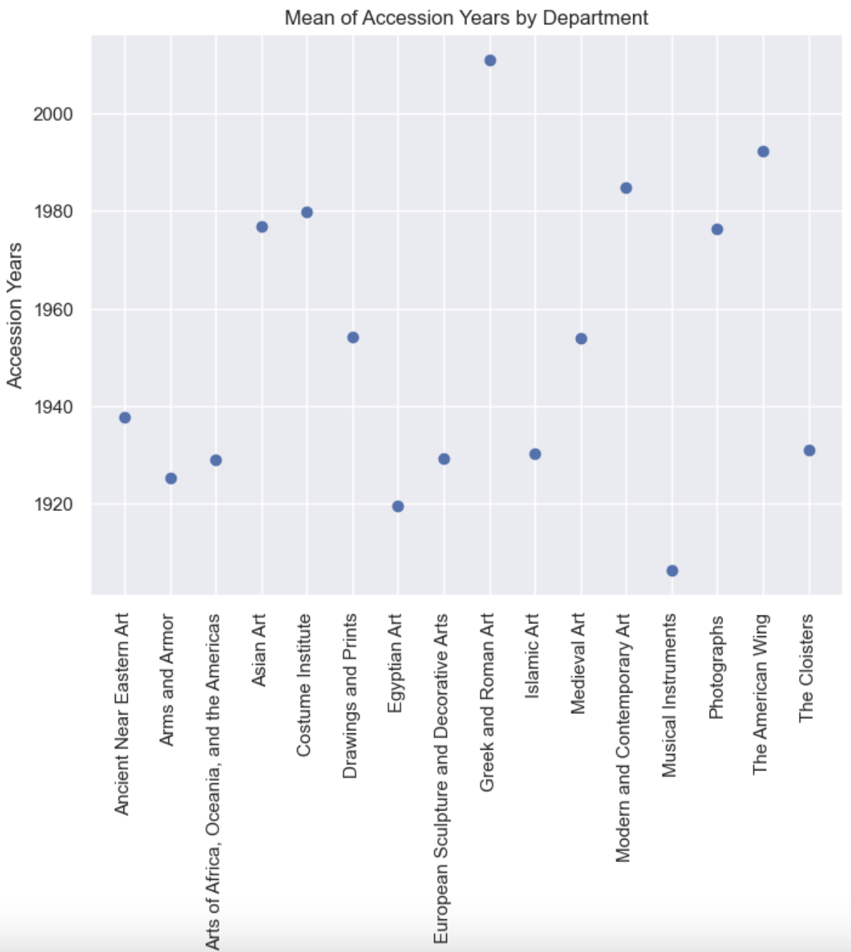
Notes:
The Met’s collection relatively well-rounded, but the majority of international art was acquired decades ago – shifting landscape in art world

Slide 10
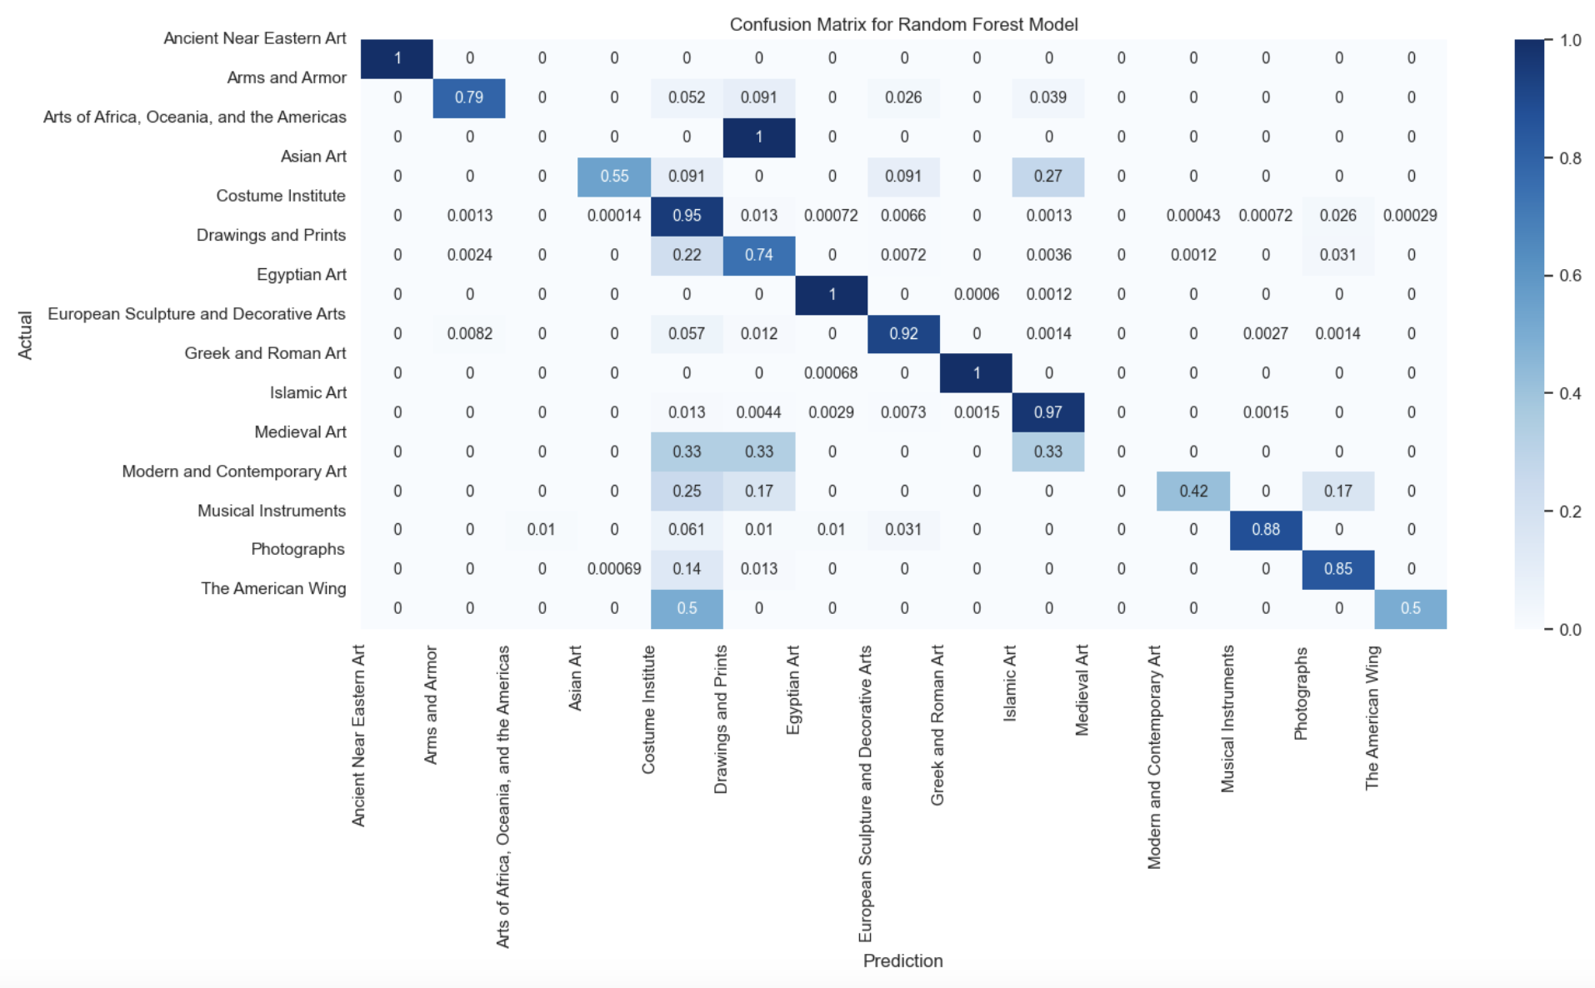

Modeling Potential
Decision Tree and Random Forest models applied to predict department classification
Random Forest always out-performed by ~2% margin
7%-12% improvement in accuracy after anomalies removed

Slide 11
Wrap-Up
The Met department classification system maps well to where models would predict objects to be.
The collection has moved to focusing more on American pieces and non-traditional art such as costuming, photography from traditional pieces
Anomaly detection allows for cleaner analysis
GitHub Repo: https://github.com/gbarela83/COMP-4447-W25-MET_DATA_ANALYSIS
Notes:
Reid and Gabe both give their own wrap-ups here to close it out

